Slide 1
Lecture 8: Integer linear programming.

Slide 2
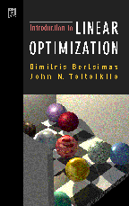
Source
Coursera course on Discrete Optimization
Bertsimas, Tsiliklis, Introduction to Linear Optimization, chapter 10, 11-2
http://www.sce.carleton.ca/faculty/chinneck/po.html
chapter 12,13

Slide 3
Planning the optimal study plan
You are given a list of courses and their schedule
Each course has a certain attractiveness (can be negative)
There are constraints on credits you have to get
There are constraints on how many classes you can take in each term
There are prerequisites

Slide 4
Binary integer linear program
Binary ILP is a systematic approach for modeling such problems:
i – courses, j – terms
whether we take ith course in the jth term
maximize total attractiveness of the schedule
cannot take the same course twice
i’ is a prerequisite for i
enough credits to graduate
you have to survive it

Slide 5
General patterns in binary ILPs
“at most one is on”
“at least one is on”
“exactly one is on”
“i th variable can be on only when jth variable can be on”

Slide 6

Team selection
….
20 players
suitability of the ith player for jth position
How to pick the optimal starting team?

Slide 7
Team selection
suitability of the ith player for the jth position
whether the ith player is chosen for the jth position
…wait, but players 12 and 17 are terrific together!

Slide 8
Set problems
Cover
A =
points
Packing
Partition
sets

Slide 9
Minimal weight set cover and ILP

Slide 10
Facility location

Slide 11

Travelling salesman problem
Exponentially many constraints!
Notes:
There should be n active edges
Every node should have 2 incident edges
Every subset should have at most |C|-1

Slide 12
Job shop scheduling
Job shop has two machines (“red” and “blue”)
Job1
1
1
Job2
2
2
Job3
3
Job4
4
4
Possible schedule:
1
2
3
4
2
1
4
total time

Slide 13
Job shop scheduling
Job1
1
1
Job2
2
2
Job3
3
Job4
4
4
+ different jobs are competing for the same machines

Slide 14
Job shop scheduling
Job1
1
1
Job2
2
2
Job3
3
Job4
4
4
How to handle “either-or” constraints in this case?

Slide 15
The “Big M” trick
M is a big constant
(e.g. bigger than the time needed for some poor schedule)

Slide 16
Job shop scheduling
Job1
1
1
Job2
2
2
Job3
3
Job4
4
4
After expressing conflicts via the “Big M” trick, we get a mixed-integer program (combines integer and real variables)

Slide 17
LP relaxation
binary integer linear program
linear program (relaxation)
(redundant if w >0)

Slide 18
LP relaxation
In some cases, the solution will be integer
In many cases, the solution will be fractional
No free lunch: the harder the problem, the smaller are our chances to get an integer solution

Slide 19
Facility location: two ILPs
Two ways to define the consistency constraints:
Lots of (C×F) constraints
Fewer (F) constraints
Two equivalent formulations. Which one is preferable?

Slide 20
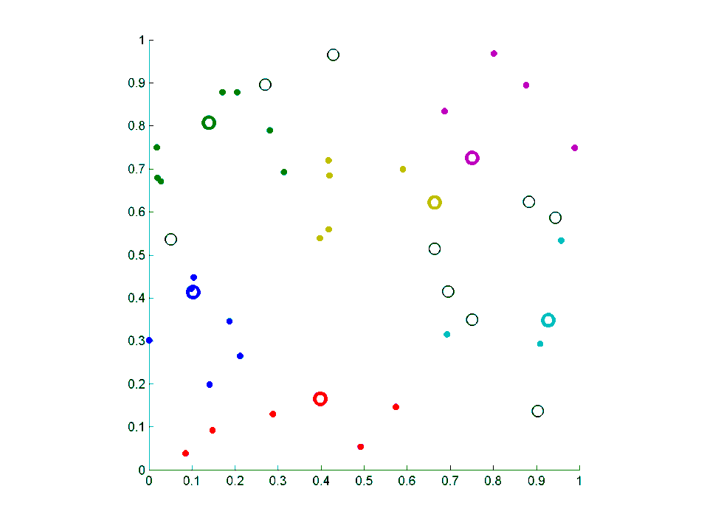
Comparison

Slide 21
Comparison
Integer program
Relaxation 1
Relaxation 2
1
0
0
0
0
0
1
1
1
1
0
0
0
0
1
1.0000
0.0000
0.0000
0.0000
0.0000
0.0000
1.0000
1.0000
1.0000
1.0000
0.0000
0.0000
0.0000
0.0000
1.0000
0.2000
0
0.0667
0.0667
0.0333
0
0.0667
0.1667
0.0333
0.1000
0.0333
0.0333
0.1333
0
0.0667
1.6871
1.6871
1.0105

Slide 22
Geometric scheme
feasible integer solutions
infeasible integer solutions
Red is an ideal relaxation (convex hull)
Green is an intermediate relaxation (some vertices are integer)
Blue is a poor relaxation (all vertices are fractional)
No non-feasible integer points can lie inside relaxations

Slide 23
When constructing of the ILP…
Try to think of as many valid constraints as possible (as long as they are not redundant from LP point of view)
Resolving fractional values is much harder then solving even very big LPs
Even exponential number of constraints can be dealt with (more in the next lecture)

